Slide 1
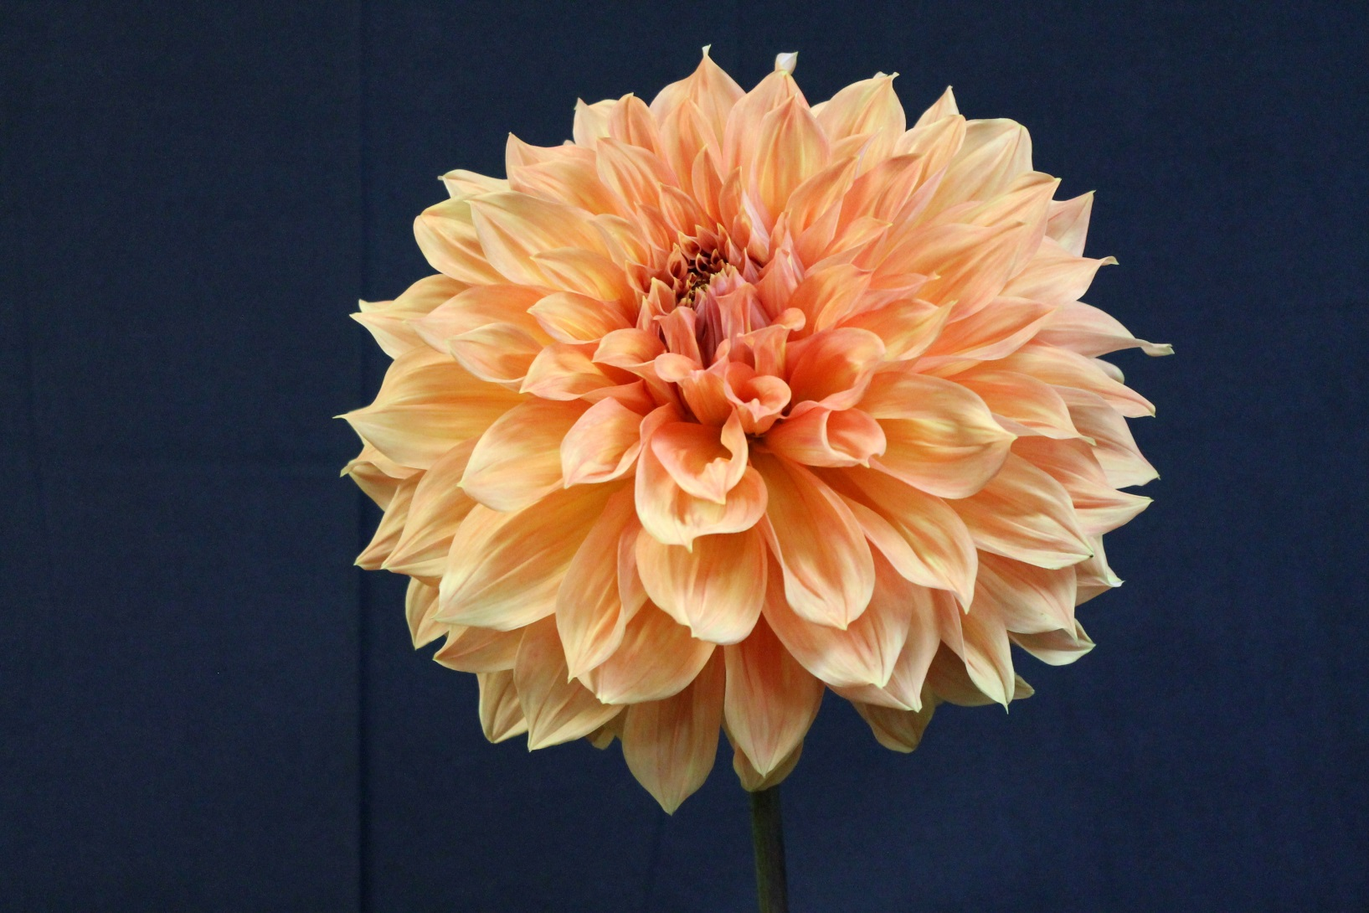
Garden Dahlia – Clyde’s Choice
Notes:
Clyde’s Choice, AA FD Or, is one of the top winning AA FD dahlias. Thus, it is a favorite AA dahlia for exhibitors. The basic problem with AA dahlias for garden use is that they give far fewer blooms than smaller dahlias. Note that this bloom has gaps near the bottom and is a bit messy around where 8 would be on a clock. Even so, it is a beautiful dahlia despite not being ideal as a choice for exhibition.

Slide 2
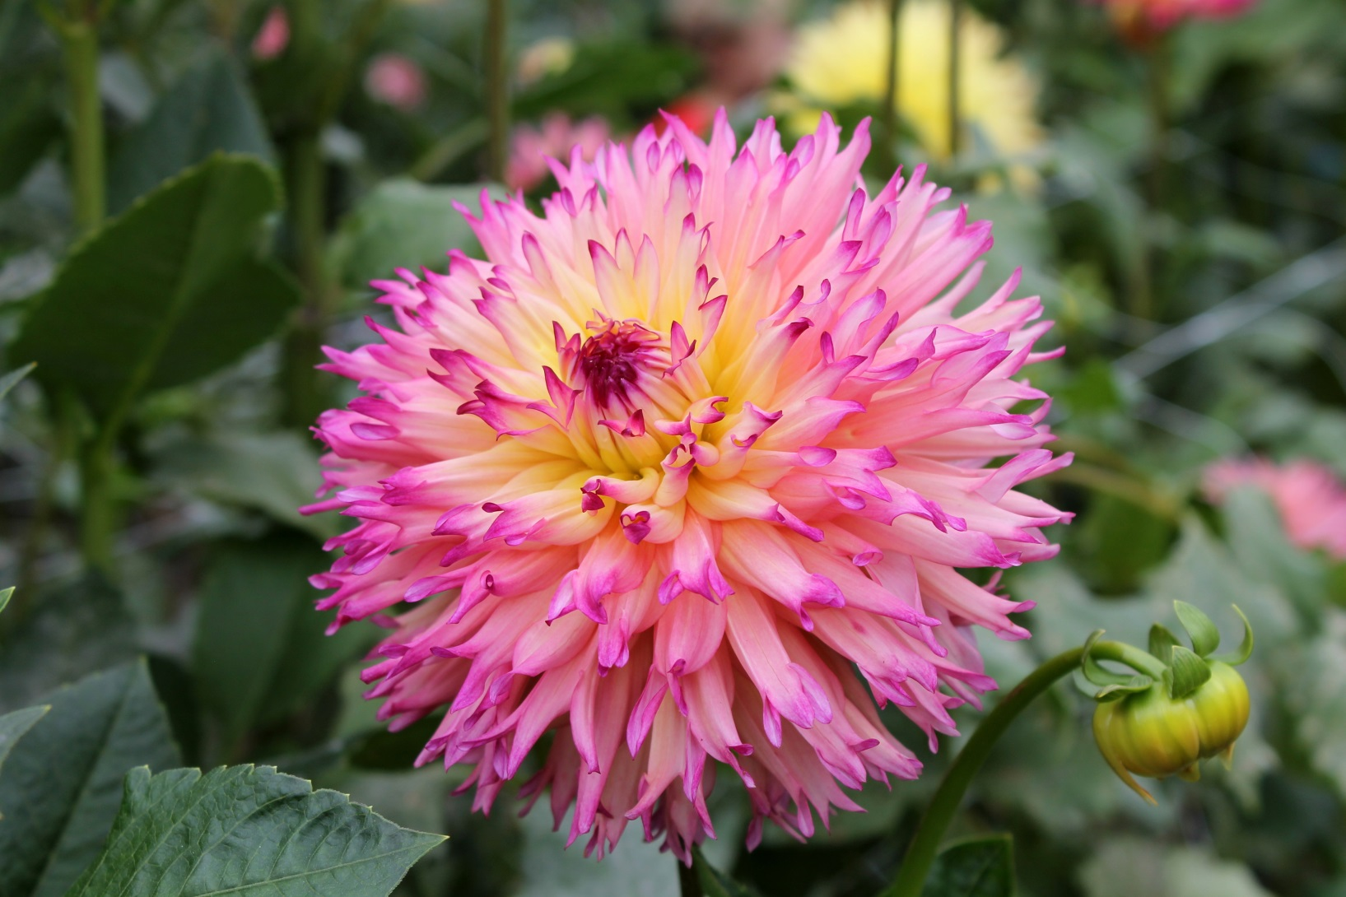
Garden Dahlia - Nenakazi
Notes:
Nenakazi, B LC LB DP/Y, was a double award winner as a seeding in 1997. I would be proud to bring this bloom to any show – it is a fine exhibition bloom. It is also a stunning garden dahlia.

Slide 3
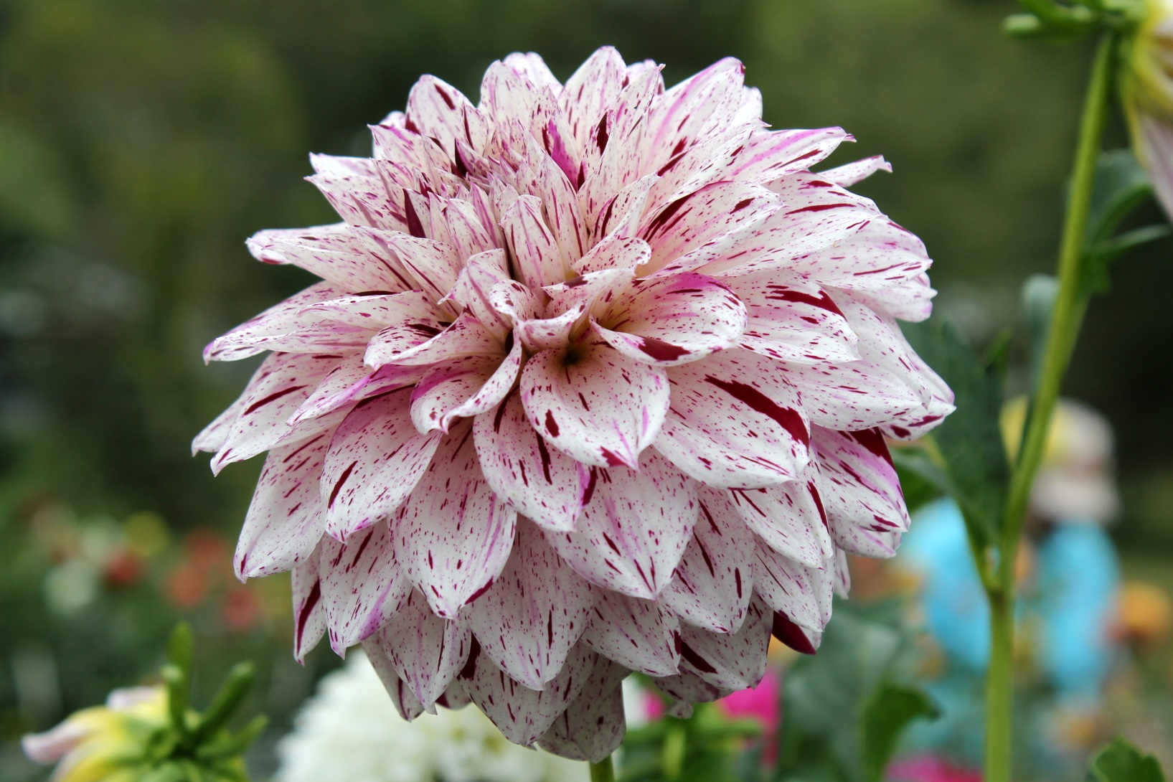
Garden Dahlia – Bristol Fleck
Notes:
Bristol Fleck, BB FD Var, PR/W, is beautiful in the garden and as a cut flower. It is a decent flower for exhibition, except for two major issues. Uniformity in color is a significant factor in judging. Variegated dahlias rarely have good uniformity of color across a single bloom or across blooms in multi-bloom entries. Also, note that the petals are large for the diameter of the bloom. Compare to some of the coming slides, where the petals are smaller (thus many more petals). A judge would consider this bloom coarse (petals too large). These factors demonstrate that a dahlia can be stunning in the garden and in an arrangement but not ideal for exhibition.

Slide 4
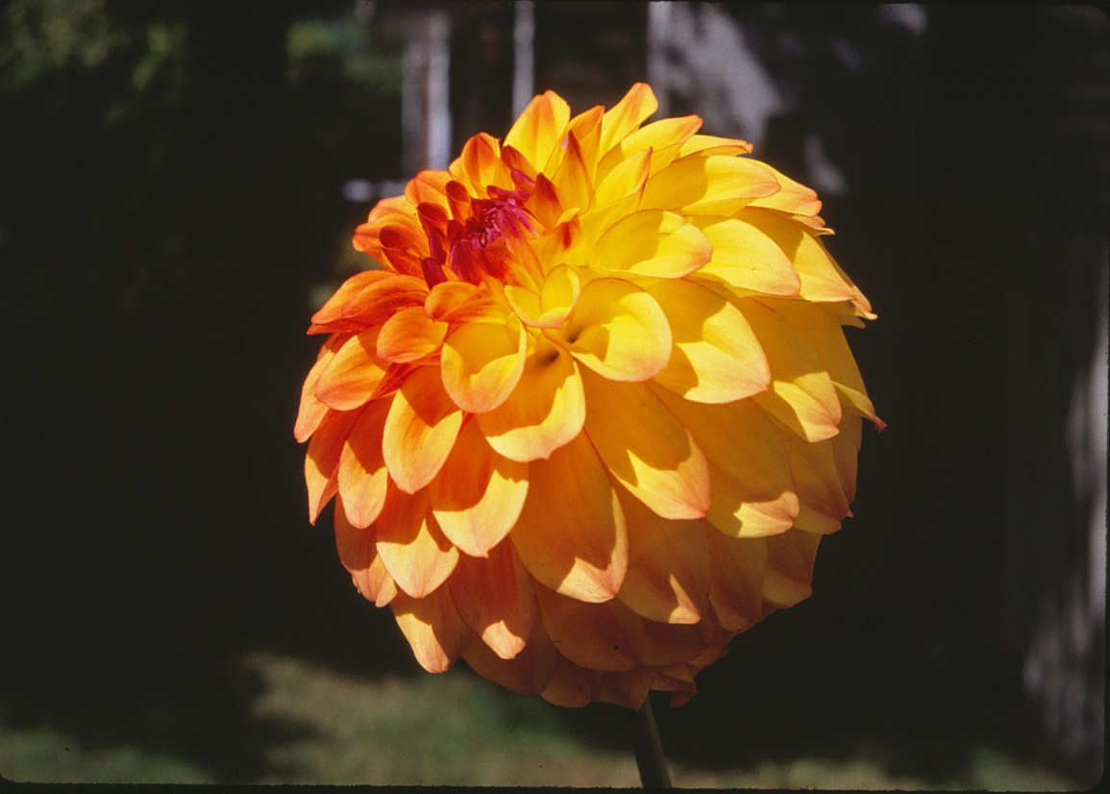
Garden Dahlia – Hy Clown
Notes:
Hy Clown, BB FD LB Y/DP, is closer to Y/OR in some gardens. Martin Kral, who chairs the photography contest for ADS, took and shared this stunning photo. Hy Clown is an exceptional garden flower – absolutely stunning. However, it is coarse (very large petals for the diameter) and therefore should rarely win in exhibition. With exceptional depth and large petals, when Hy Clown opens to the stem, the depth can be greater than the diameter. The overall effect can be a bloom in the shape of an egg rather than round. Departing from a round overall shape is another significant fault in form for a dahlia. While Hy Clown should not win at shows, it is an absolutely stunning garden flower.

Slide 5
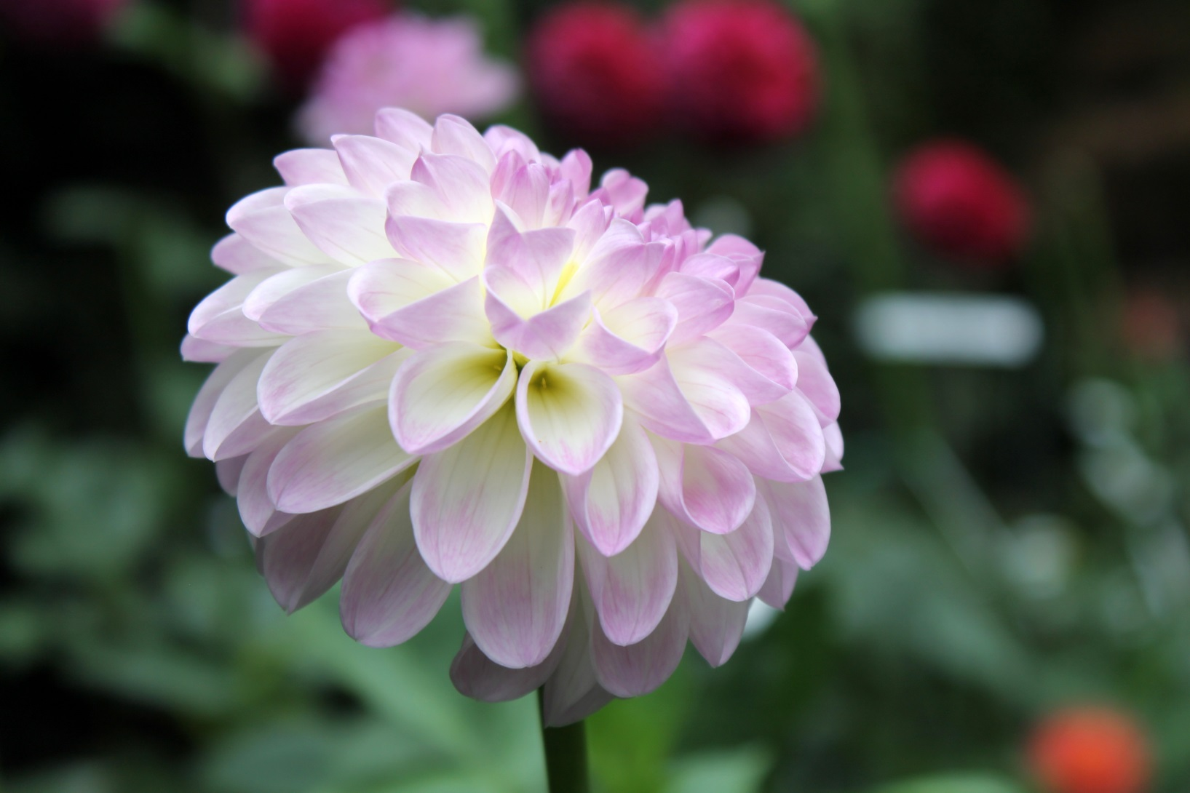
Garden Dahlia - Abbie
Notes:
Abbie, Min FD LB W/Pk, is another stunning garden dahlia that is too coarse for exhibition. This beautiful dahlia form the U.K. is excellent for beauty in the garden and nice in arrangements. It is easy to grow and gives many blooms.

Slide 6
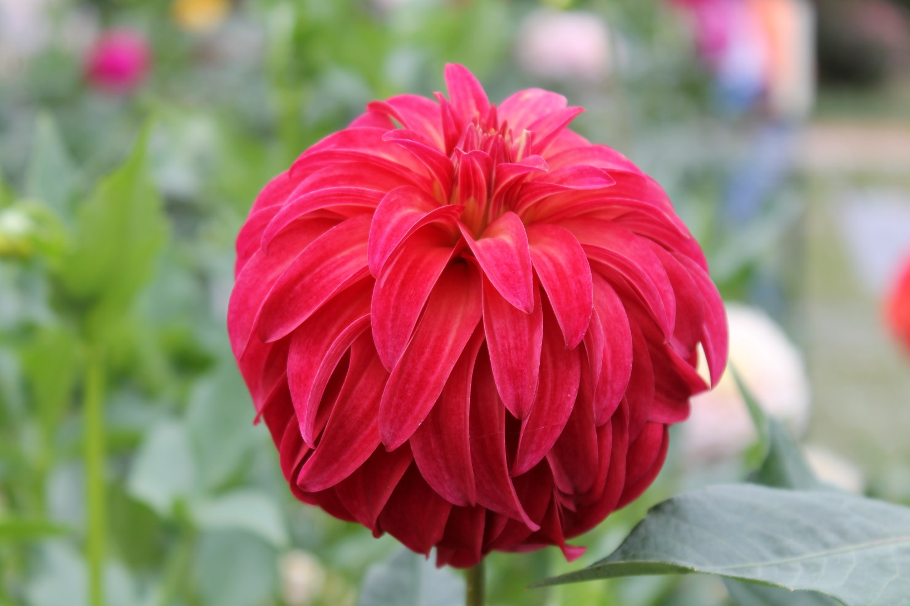
Garden Dahlia – Prissy
Notes:
Prissy, a red stellar, has a non-fading, bright red color that shows very well in the garden. The foria mess, wth petals going in several different directions. Prissy is not in the 2018 Classification Handbook of Dahlias, an indication that it does not do well in competition.

Slide 7
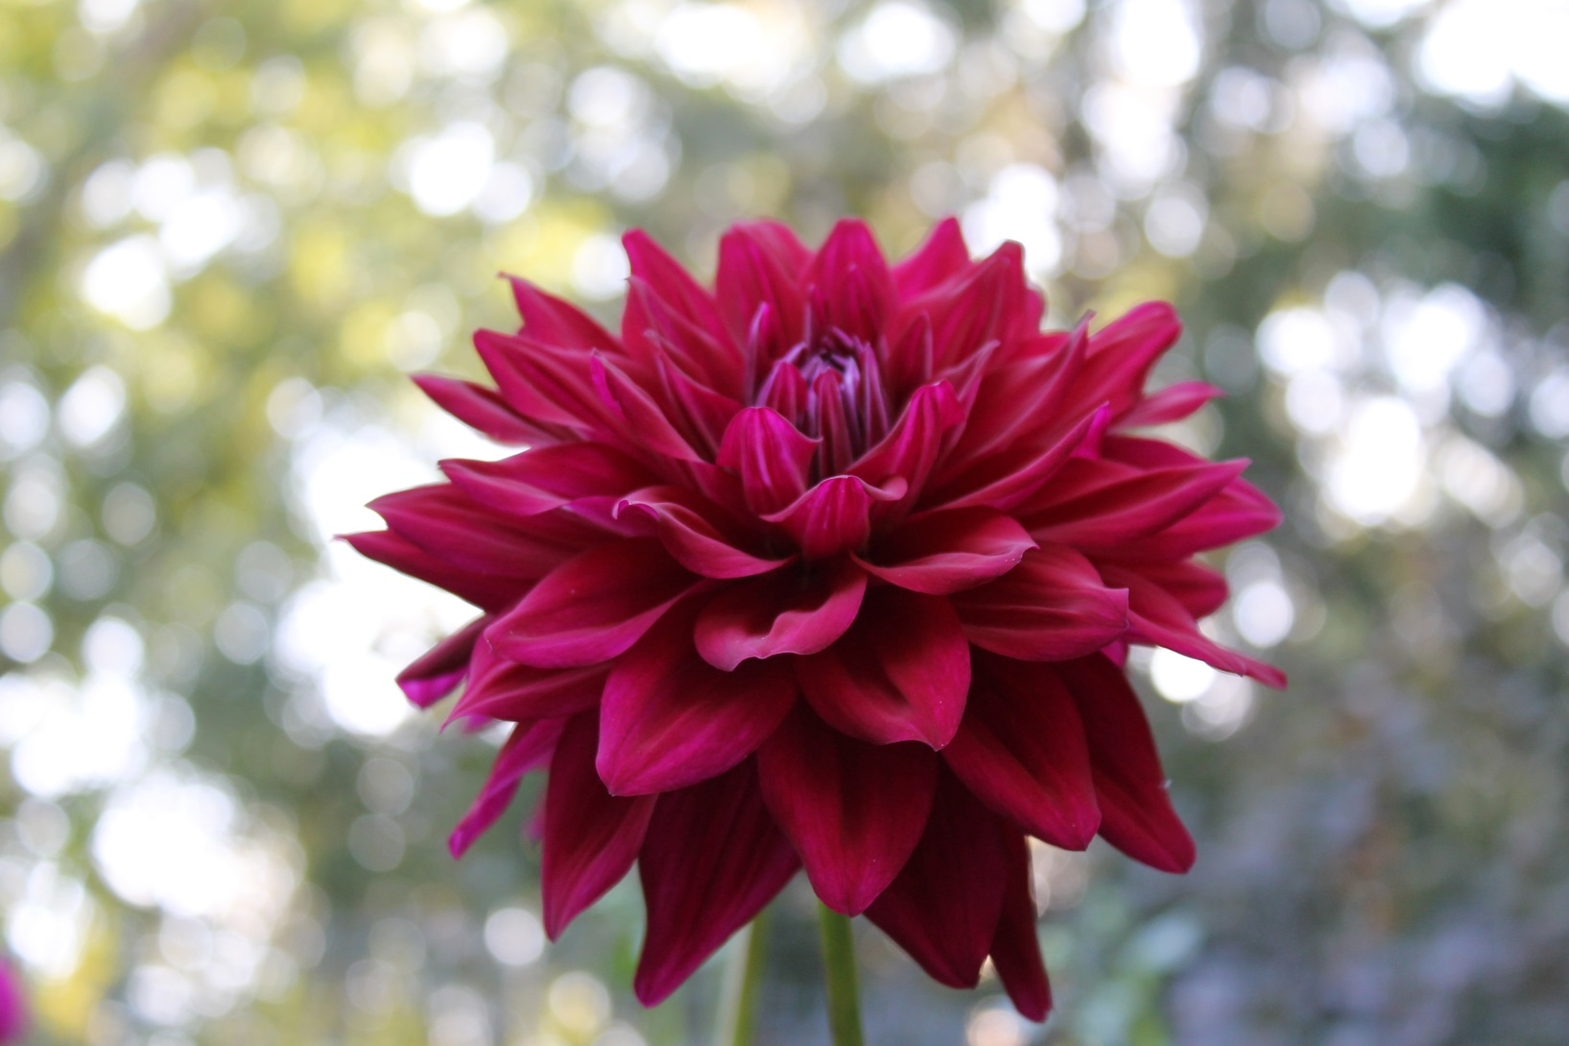
Garden Dahlia – Purple Pop Talk
Notes:
Pop Talk, BB ID Var L/Pr, was my favorite “people’s choice” dahlia for many years. Unfortunately, my stock reverted to all purple a few years ago. (The actual color is purple, even though it comes through in the photo as a dark red.) The petals are pointed (less desirable than rounded) and coarse. The blooms do not have enough petals, so they do not open to the stem (insufficient depth). As an exhibition dahlia, this bloom should not win a blue ribbon. However, it is a nice garden dahlia and beautiful in arrangements. I have a commercial grower who will make it available in 2019 or 2020 as a garden/arrangement dahlia. I hope never to see it at a dahlia show, except in arrangements.

Slide 8
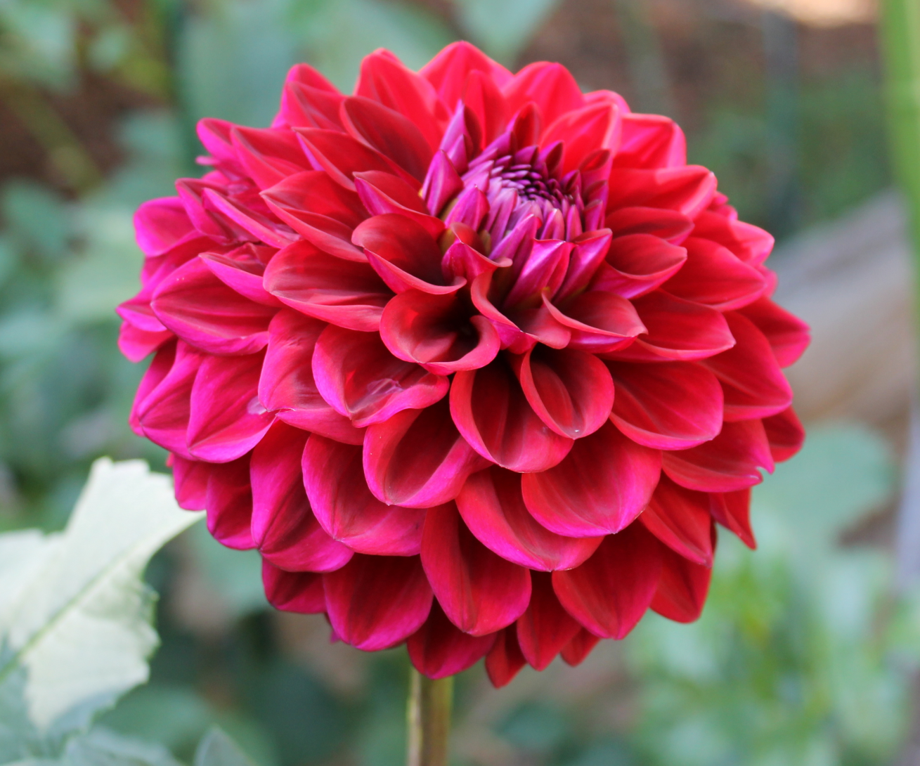
Garden Dahlia – Hart’s Lora Ann
Notes:
Hart’s Lora Ann, BB FD DR, is actually darker than the photo represents. This photo does not show the beautiful regular form of the petals on an excellent bloom. The problem with this dahlia for exhibition is that it is coarse – the petals are too large to be competitive with better BB FD dahlias with more and smaller petals regularly arranged. As a garden flower and bloom for arrangements, it is stunning.

Slide 9
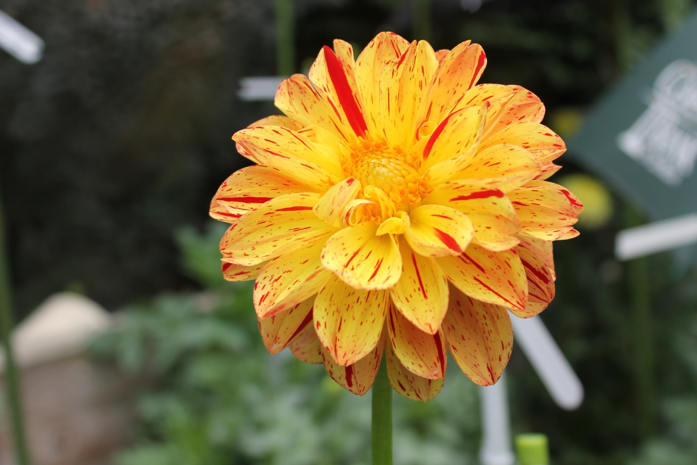
Garden Dahlia - Phrog
Notes:
My local society has an annual competition for first year seedlings. The prizes are King, Queen, Prince, and Frog. Frog is the prize for ugliest well grown entry. The seedling easily won Frog in 2014. It is a Peony dahlia, variegated, in yellow and red. The original peony dahlias from the 1930s had a few rows of floppy, large ray florets (petals) and an open center. In the past few decades, there have been new peony dahlias, such as Elvira, that are much more petite in size of bloom and size of petal. There are no size criteria for peony dahlias, so this dahlia, which I named Phrog, in honor of judges in my home society, meets the form definition as well as Elvira, with its much smaller proportions. There are no variegated peony dahlias, so there is no competition in its class. This dahlia is stunning in the garden and in arrangements, yet many judges will hate it. I have a commercial grower who will introduce it in 2020 – again for garden and arrangement use. I do not expect to see Phrog on the exhibition table at many shows, but who knows?

Slide 10
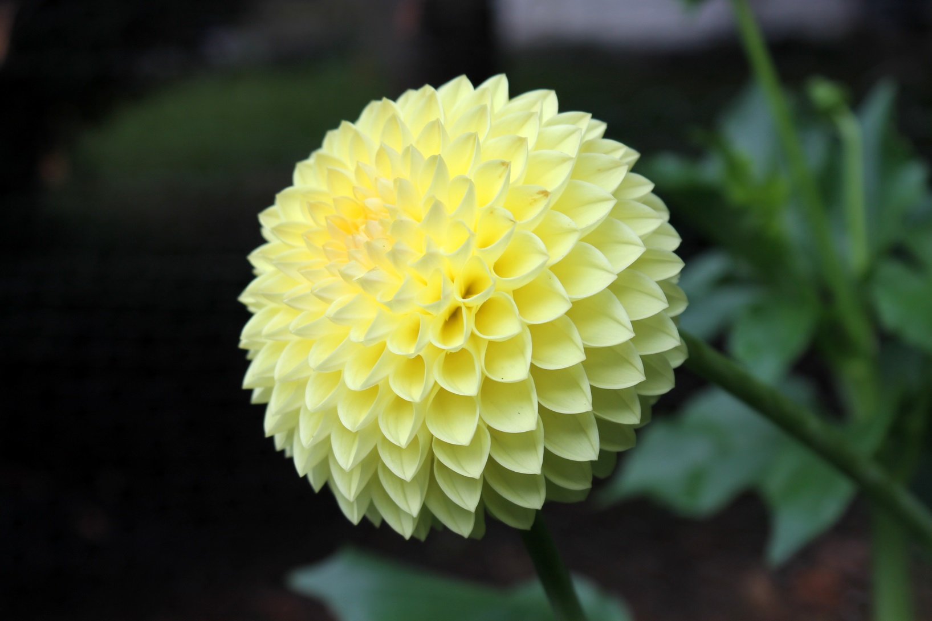
Garden Dahlia – Rossendale Lewis
Notes:
Rossendale Lewis, Min FD Y, demonstrates an outstanding exhibition dahlia. Note that the petals are petite and uniformly arranged around the center. (Sorry about the photo quality. Yellow can be difficult to photograph well.) Compare these petals to those on blooms that I describe as coarse. The smaller and regularly arranged petals tend to be more pleasing, and one can see why Rossendale Lewis is an outstanding exhibition dahlia in the U.K. When this dahlia becomes better known in North America, it should be an outstanding exhibition dahlia in ADS as well. Would a casual gardener want this dahlia in the garden over some of the others?

Slide 11
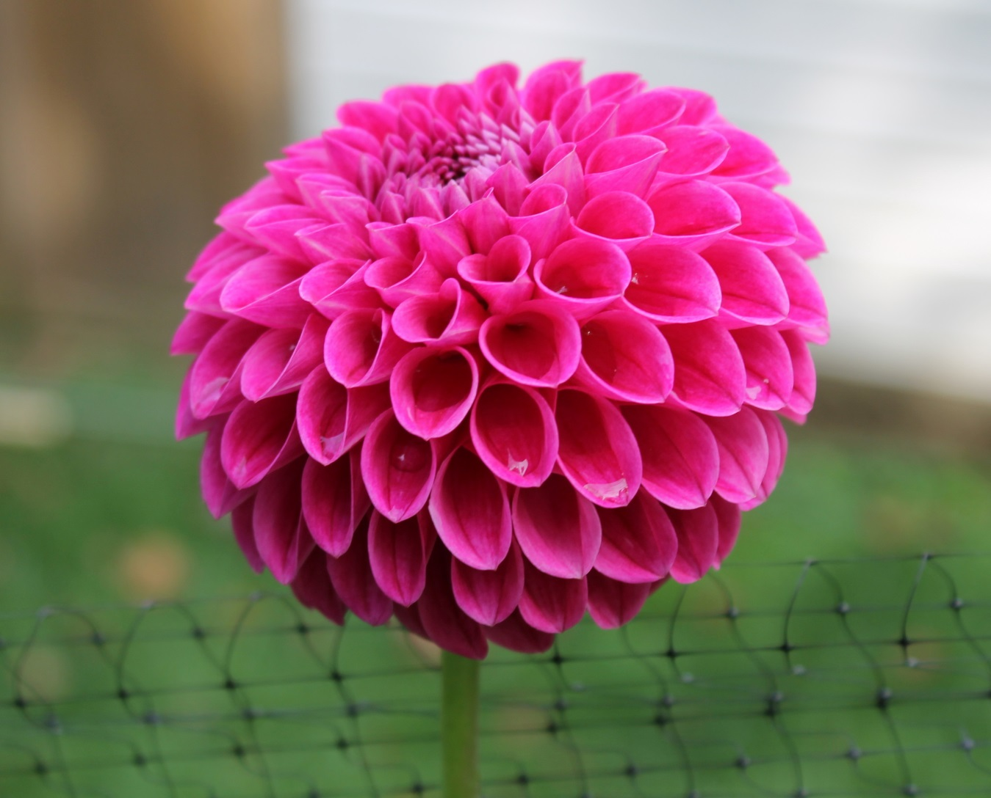
Garden Dahlia – 15-6005
Notes:
This dahlia, which is between FD and BA in form, is a miniature that seems to be more FD in warm weather and closer to MB in form in cold weather. The color is a pleasing dark pink. It is one of my seedlings from 2015 and may eventually make it to market. The color is stunning, and it is beautiful in the garden. Compare it to Rossendale Lewis – the petals are a bit large and coarse, but the form is regular. Since the key to a dahlia is what judges say, not the opinion of the originator, let’s see what happens. Meanwhile, it is nice in the garden and arrangements.

Slide 12
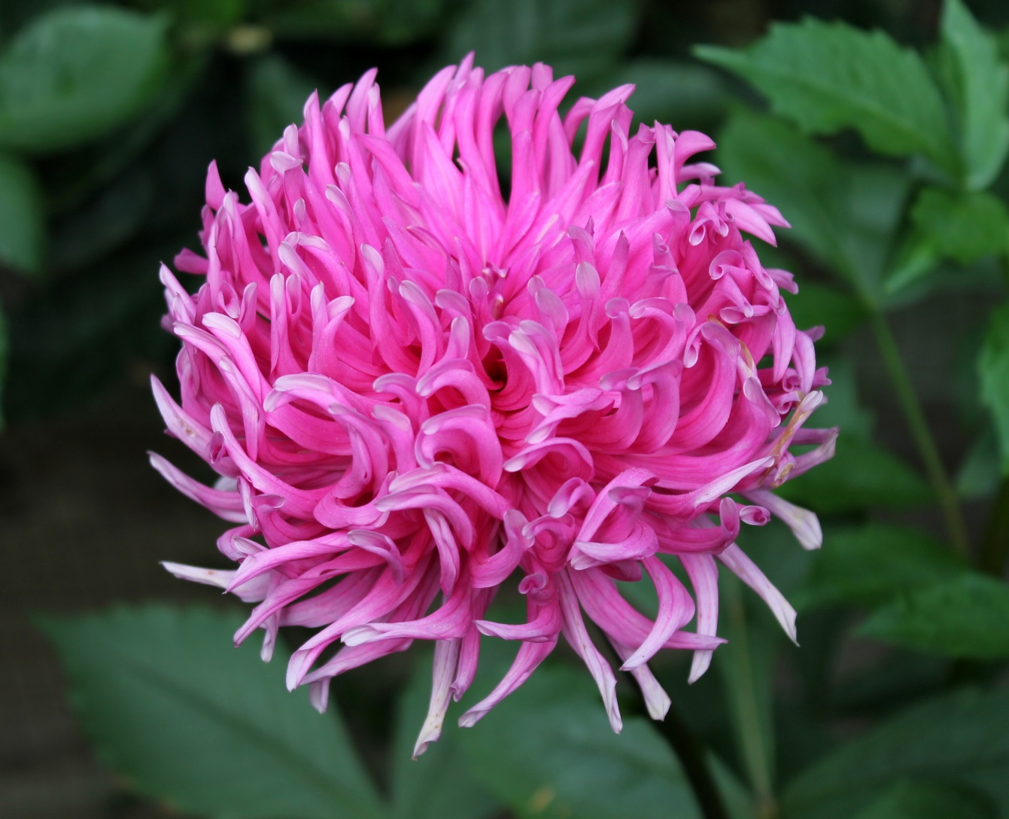
Garden Dahlia - Jane
Notes:
Jane, BB IC Pr (although deep pink for me), showed up somewhere in 1992. A friend gave me a tuber several years ago, and I love this dahlia. In the UK, exhibitors would pull out some of the back petals that provide an appearance that one might describe as a “bad hair day.” The deep incurving is stunning, as is the deep pink color. This dahlia could be useful for shows, but it is absolutely stunning in the garden and in arrangements.

Slide 13
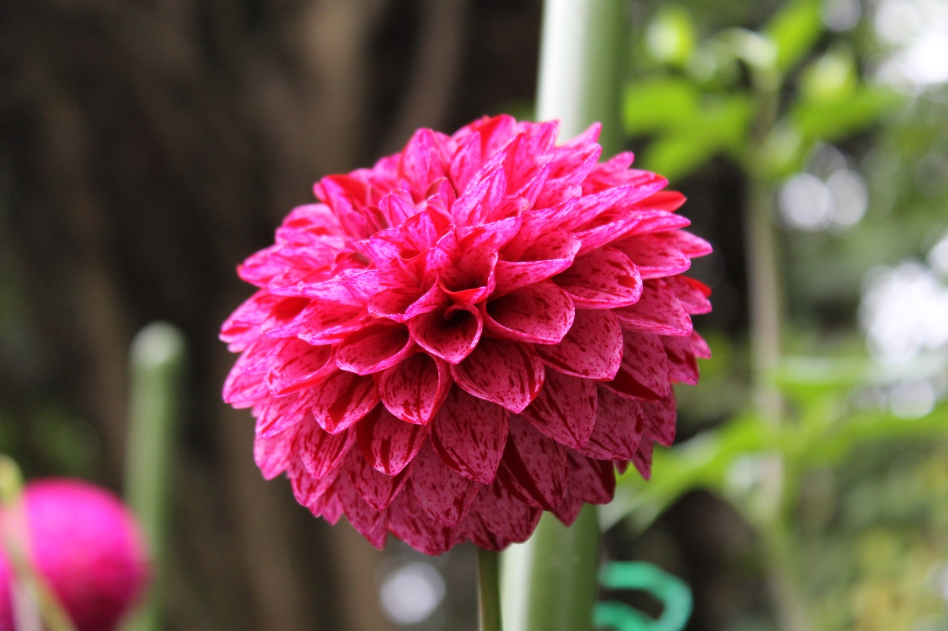
Garden Dahlia – Danny Boy
Notes:
Danny Boy, Min FD Var DP/DR, has an absolutely stunning color combination. The variegated is more subtle than ideal, and the petals are more coarse than ideal. The problem I had is that in my area, the centers open up before the blooms open deep enough. In the Pacific Northwest, growers do not have that problem. Danny Boy is absolutely stunning in the garden and in arrangements.

Slide 14
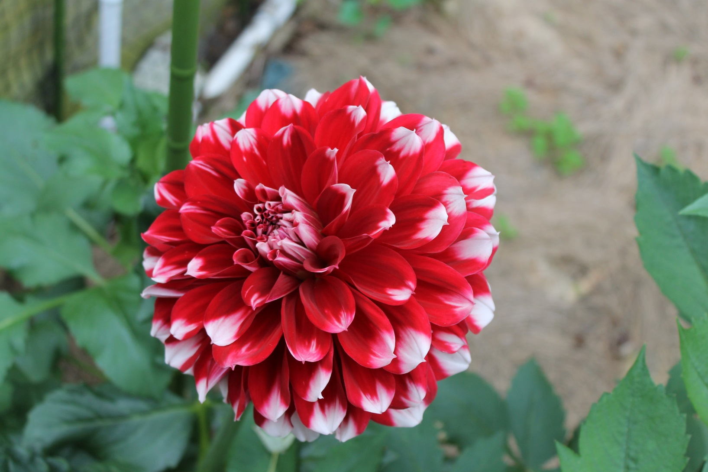
Garden Dahlia Bernardo
Notes:
Bernardo, B FD Bi R/W, is the lowest growing dahlia in my garden (less than 3 feet tall). Short, compact plants produce full B sized blooms that burst with unexpected size and color. If better known, this lovely dahlia would be very popular. The color is not uniform enough for exhibition purposes, but it is very nice in the garden.

Slide 15
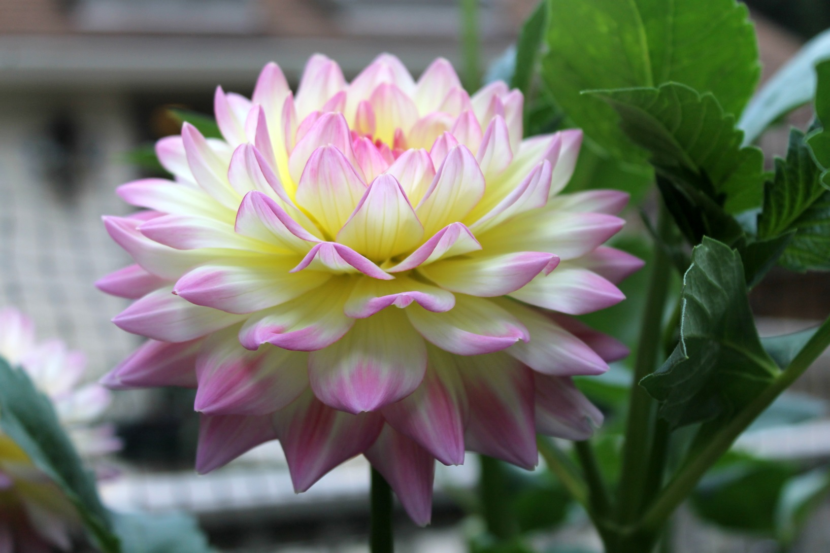
Garden Dahlia – Hapet Duo
Notes:
Hapet Duo, BB FD LB Y/Pk, came from Austria as a waterlily. In this photo, the petals are upside down for a waterlily, although I have had blooms that open correctly and cup up. If shaded, the color is absolutely stunning – perhaps the most beautiful color combination I have. With petals that sometimes open “upside down” for a waterlily, and with too much depth for ideal WL form, the classification committee made this dahlia FD rather than WL. As FD, the petals are too coarse to be competitive, and there are insufficient petals (does not open deep enough). However, the color is absolutely stunning, and it is an excellent tuber maker. Despite my desire to exhibit all my dahlias, I continue to grow a few plants of Hapet Duo, because it is one of my favorite dahlias.

Slide 16
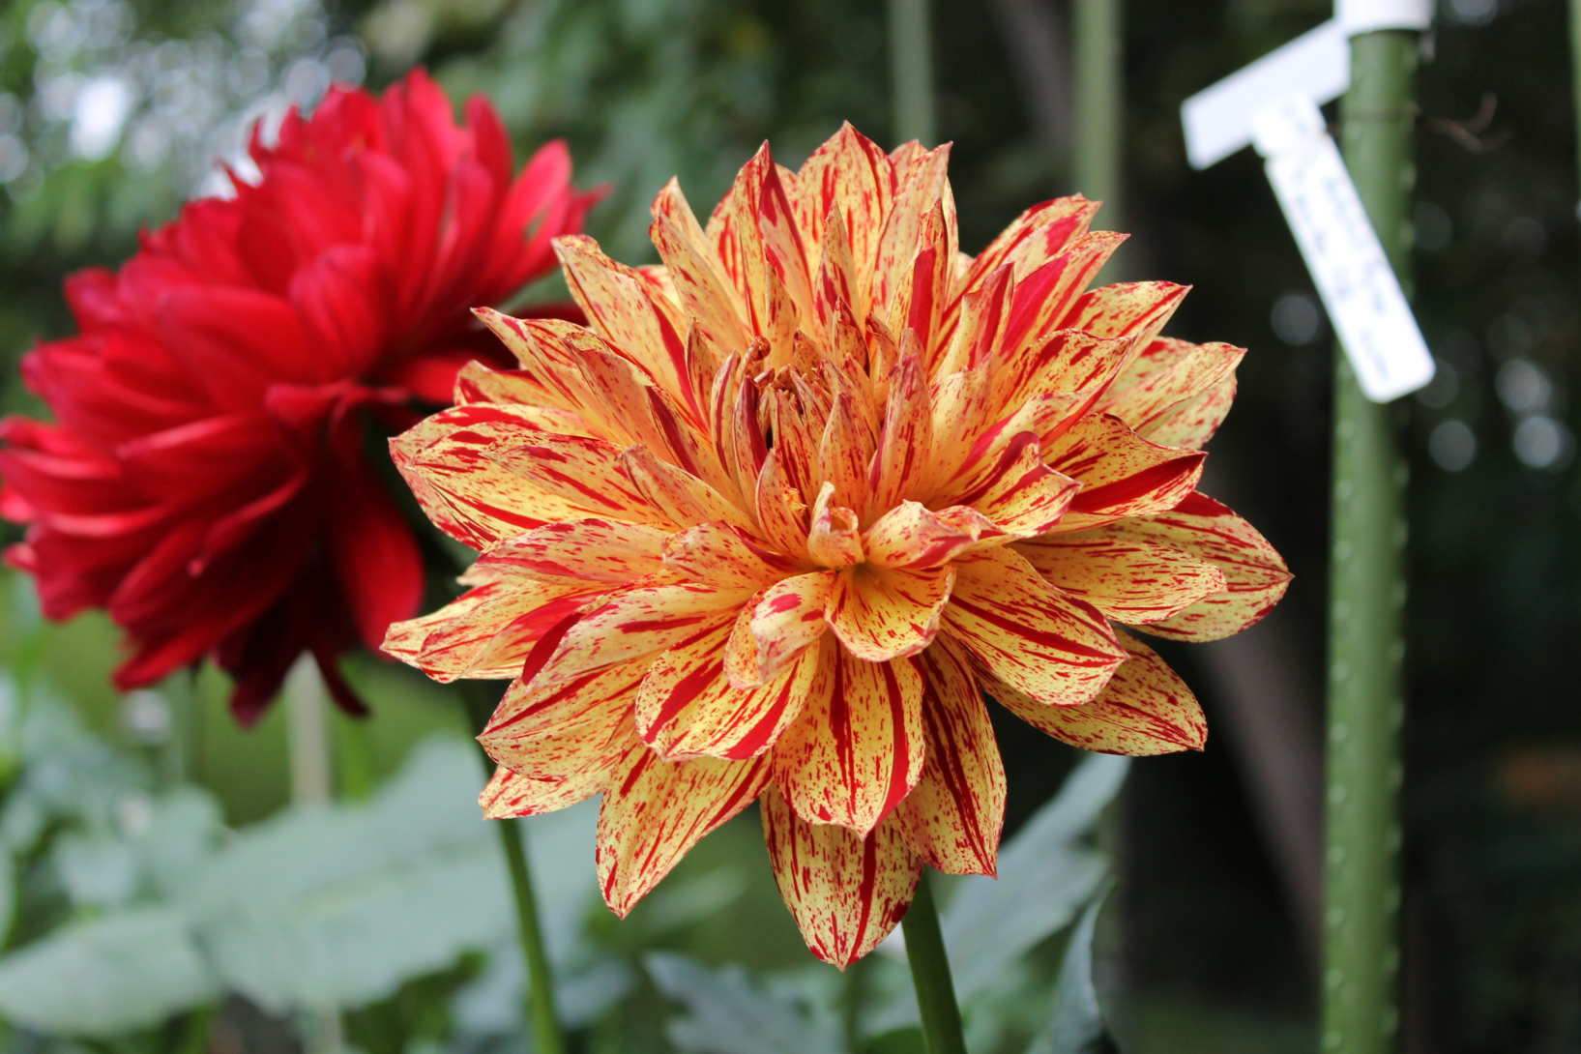
Garden Dahlia – Hollyhill Tigress
Notes:
I have always loved variegated dahlias. Hollyhill Tigress, WL Var Y/R, is stunning in the garden and in arrangements. Tall plants are prolific, but some blooms come out all red rather than variegated. The WL form is good (usually better than in this photo), although lack of uniformity makes it difficult for any variegated to win best of category. I continue to grow this dahlia and to bring any good blooms for show – but I also love it for garden display and arrangements.

Slide 17
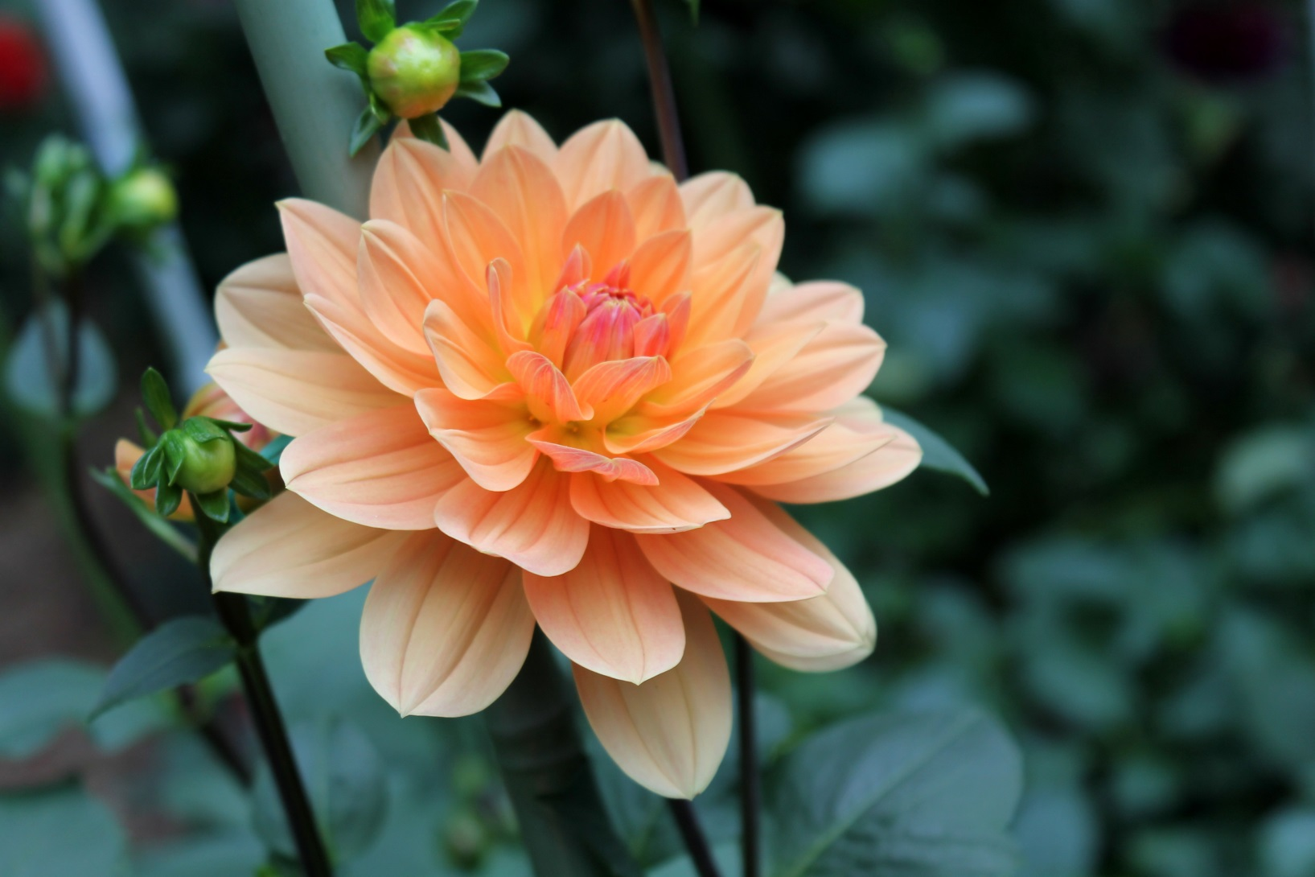
Garden Dahlia – Apricot Beauty
Notes:
Apricot Beauty, WL Or, from Geerlings in Holland, is extremely prolific. WL form is marginal. Strong growing plants slightly shorter than average are extremely prolific, and the plants make plenty of tubers. Apricot Beauty is beautiful in the garden, but I do not expect to bring blooms to shows.

Slide 18
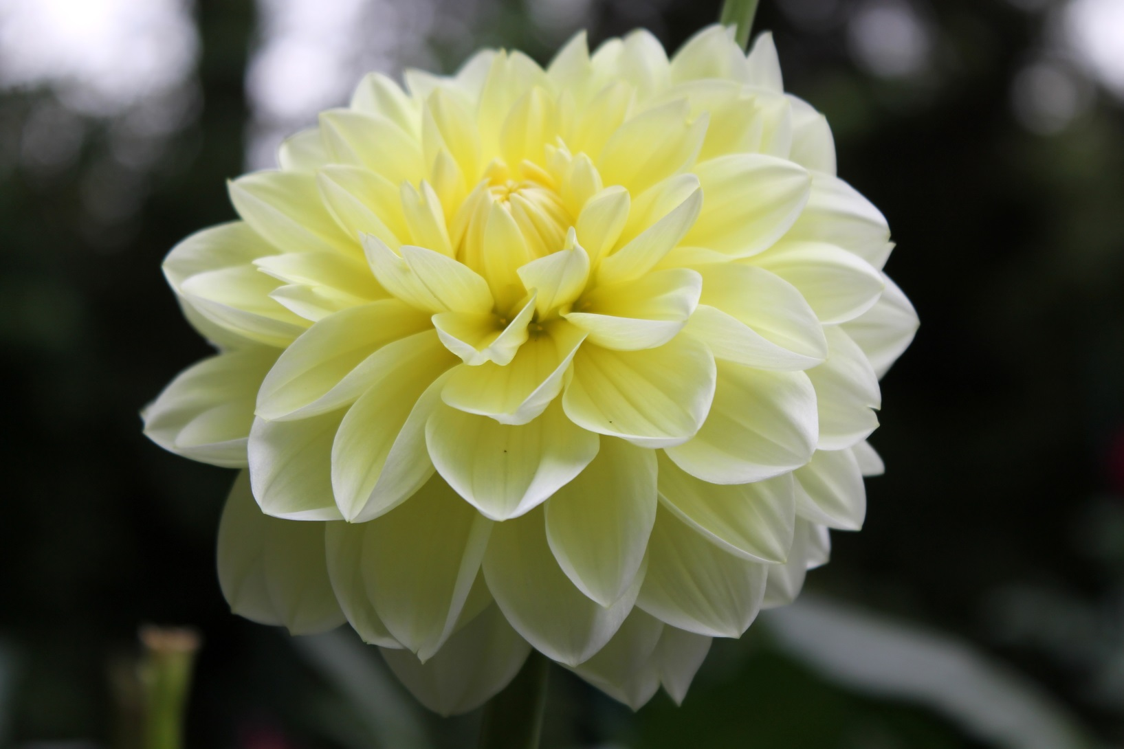
Garden Dahlia – Harriet G
Notes:
Harriet G, WL Y, comes from the U.K. The petals are small and more cupped than ideal for a WL. The pale yellow is attractive in the garden, but in several seasons growing this dahlia, I have never had a bloom worthy of exhibiting.

Slide 19
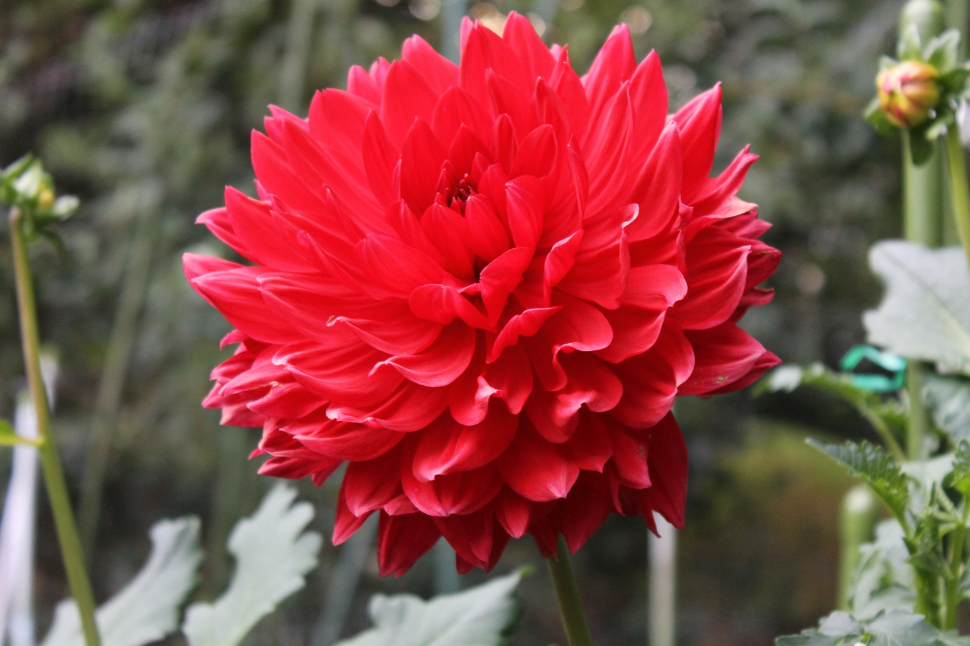
Garden Dahlia - Elly
Notes:
Jan Geerlings liked this dahlia well enough to name it for his partner, Elly. The blooms are about the largest (in diameter) of any waterlily I have seen, but there are too many petals, and the petals tend to come upside down. It is not an exhibition dahlia, but what a beauty in the garden!

Slide 20
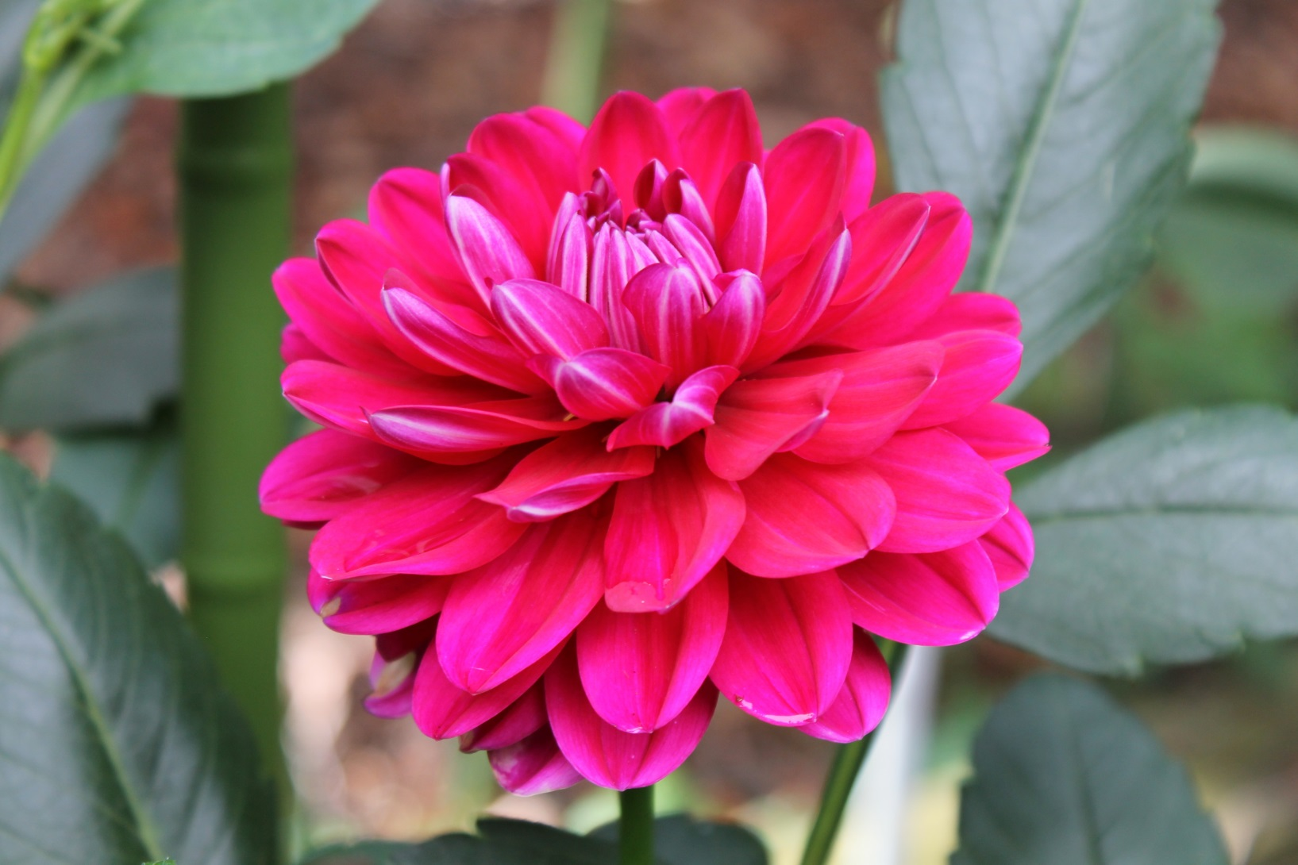
Garden Dahlia – Hapet Charmante
Notes:
Hapet Charmante, Min FD DP, is one of the most stunning dahlias I have seen. My photos cannot do justice to the stunning color. Unfortunately, I lost my stock of this dahlia, and it is difficult to obtain Hapet dahlias from Austria. (Some commercial growers in North America have been able to obtain stock and introduce some of the Hapet cultivars.) Hapet Charmante is between FD and WL in form – too coarse to be competitive as FD and too deep plus not cupped enough to be competitive as WL. However, the dark foliage and stunning color (much nicer than in my photo) make this dahlia a winner as a garden flower and dahlia for arrangements. If you can find stock, grab it and share it with me!

Slide 21
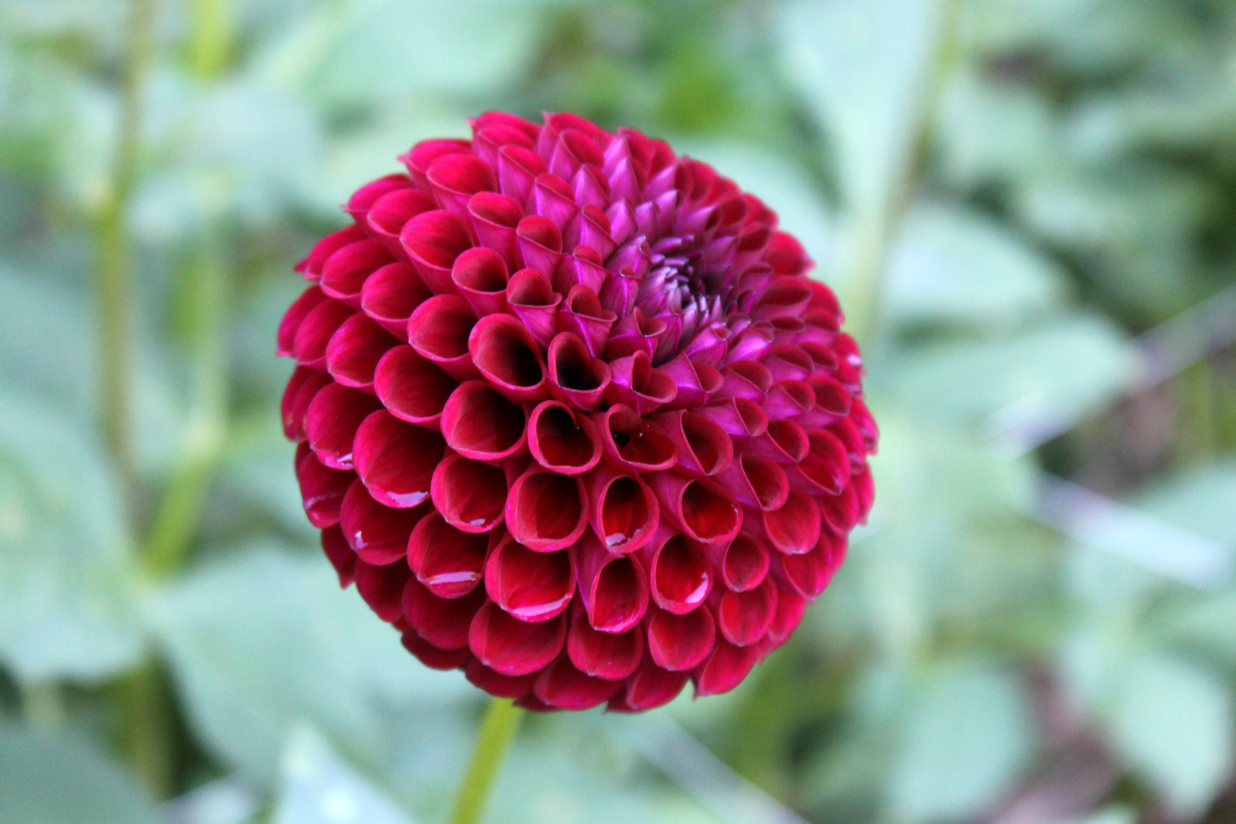
Garden Dahlia – Chimacum Zyair
Notes:
Chimacum Zyair, MB Pr, is one of a few outstanding purple miniature ball dahlias that Dave and Leone Smith have introduced. Again, it is difficult to capture purple with a camera. The form is stunning – very slightly coarse, but I would be honored to bring such a beautiful bloom to any dahlia show. This photo shows that some outstanding exhibition dahlias can be wonderful for garden display and arrangements.

Slide 22
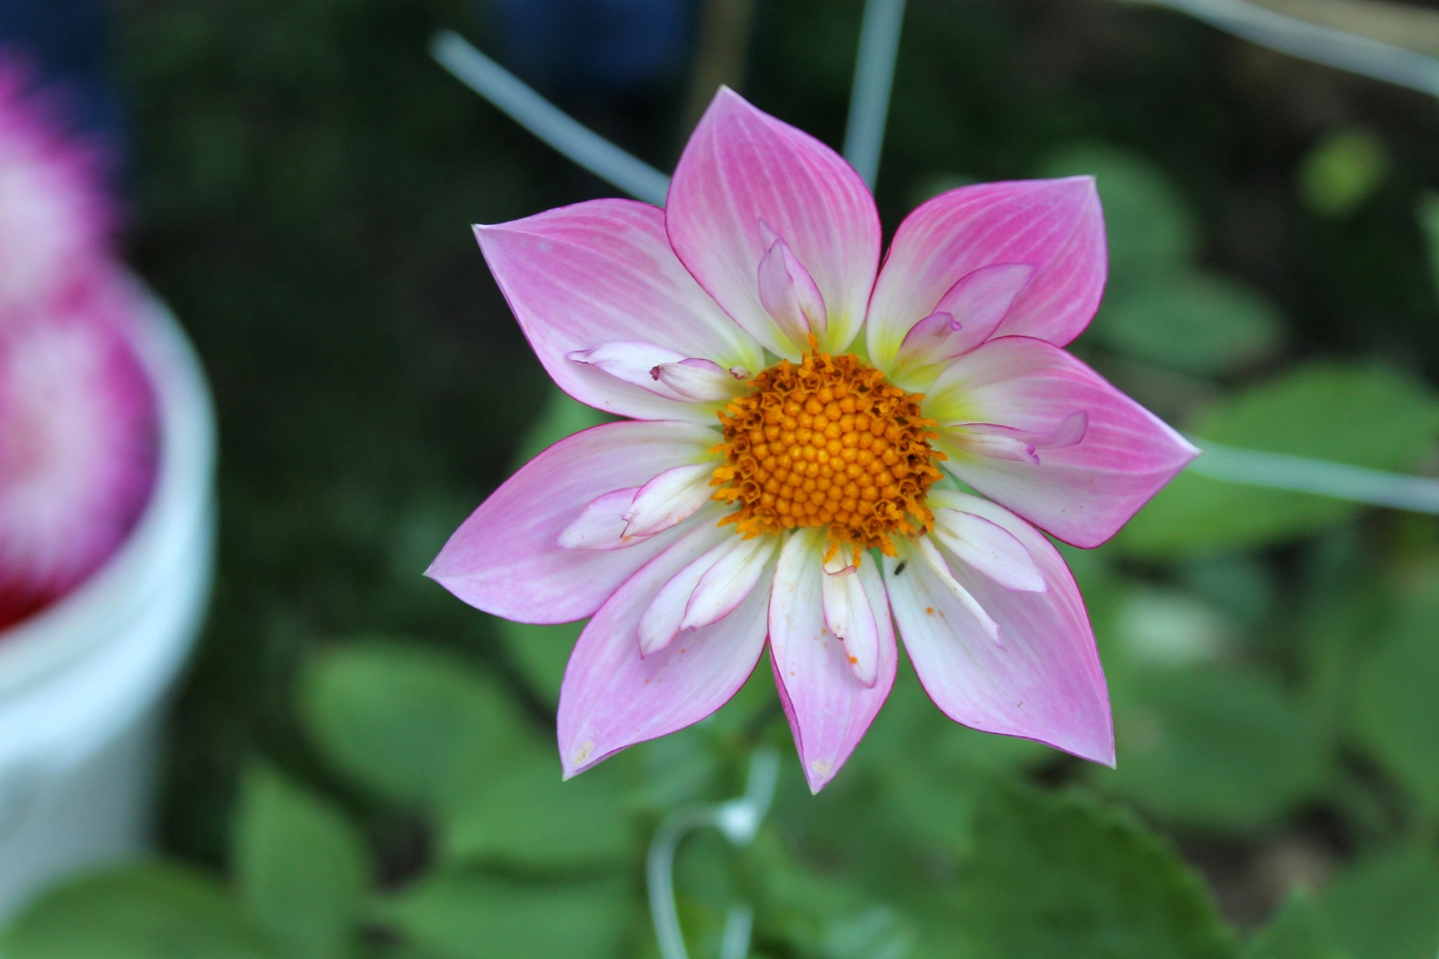
Garden Dahlia – Alpen Diamond
Notes:
I wish that I had a photo of a better bloom of Alpen Diamond. Bill McClaren, originator of the Alpen dahlias, was one of the most influential dahlia mentors in the post World War II period. He passed away early in 2018 around age 90. Alpen Diamond, CO LB L/W w,, has perhaps the most beautiful color combination of any collarette dahlia. The form on a better bloom is very uniform. This dahlia is another example of how a wonderful garden dahlia can also be excellent for arrangements. Hopefully at some point I can substitute a better photo of this outstanding dahlia.

Slide 23
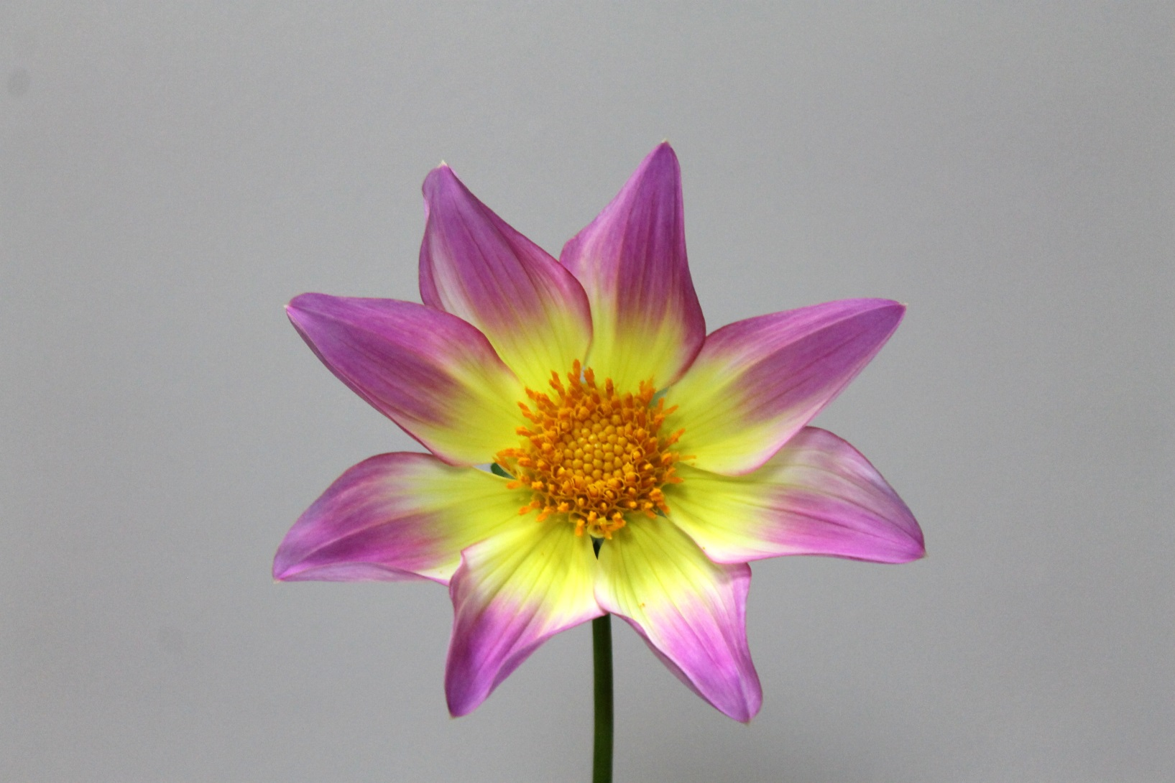
Garden Dahlia – Marcella Louise
Notes:
Marcella Louise, a single dahlia in a stunning combination of lavendar and yellow, is wonderful in the garden and for arrangements because of the bright colors. As an exhibition dahlia, the petals in this bloom are not uniform enough, especially in spacing around the center, to be ideal for exhibition. To add stunning color, however, what a wonderful choice!

Slide 24
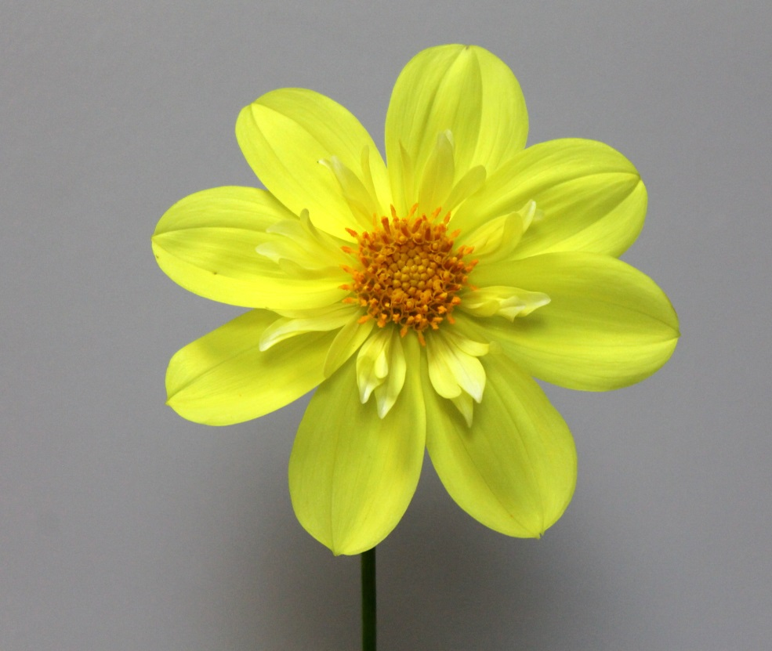
Garden Dahlias – Baron Aunt Dorothy
Notes:
Baron Aunt Dorothy, CO Y/y, has bright yellow ray florets and the same bright yellow petaloids. This bloom shows problems with uniformity of the ray florets – differences in sizes and gaps in some areas (such as 8 o’clock) and overlapping ray florets elsewhere. Again, open centered dahlia types, especially some with great color, can make wonderful garden dahlias.

Slide 25
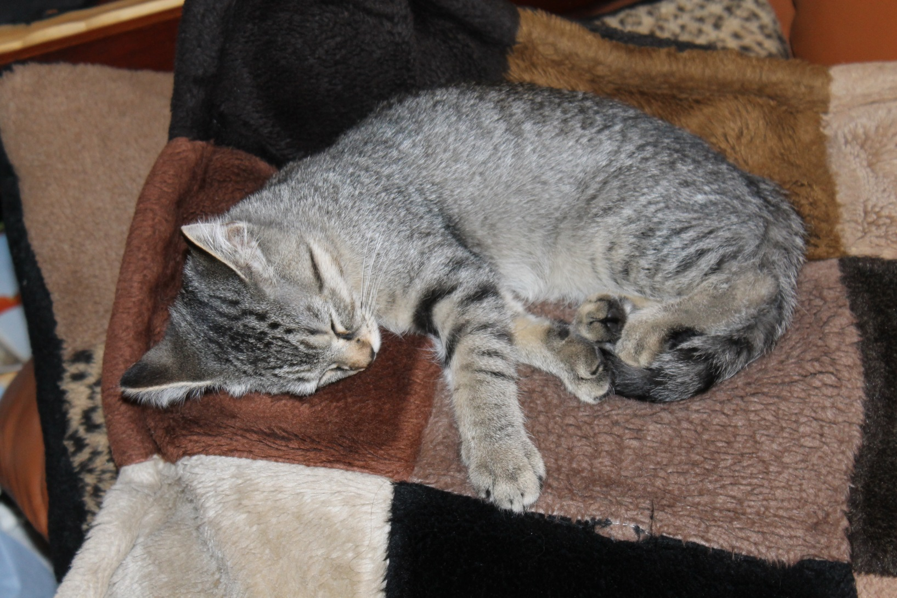
Garden Dahlia – 2015-Sdlg BB FD DB
Notes:
This 2015 seedling, BB FD DB Gray, black, and white, is very attractive for garden display. The bloom has closed up for the night, so the photo is not ideal. Note imperfections in color uniformity across the bloom. The petite size of the petals is a plus in form. This seedling shows some promise for exhibition as well as great potential for garden and arrangement use.

